Slide 1
Dhaka University of Engineering and Technology, Gazipur
Dept. of Computer Science and Engineering
1
PRESENTATION ABOUT OBJECT ORIENTED PROGRAMING FINAL PROJECT ON
“LEAVE Management System”
Presented To
Mr. Md.Omor Farque
Associate Professor, CSE
Mss. Sabah Binte Noor
Assistant Professor, CSE
Presented By
Chaina Khatun
Std-ID: 194113
CSE 2/1

Slide 2
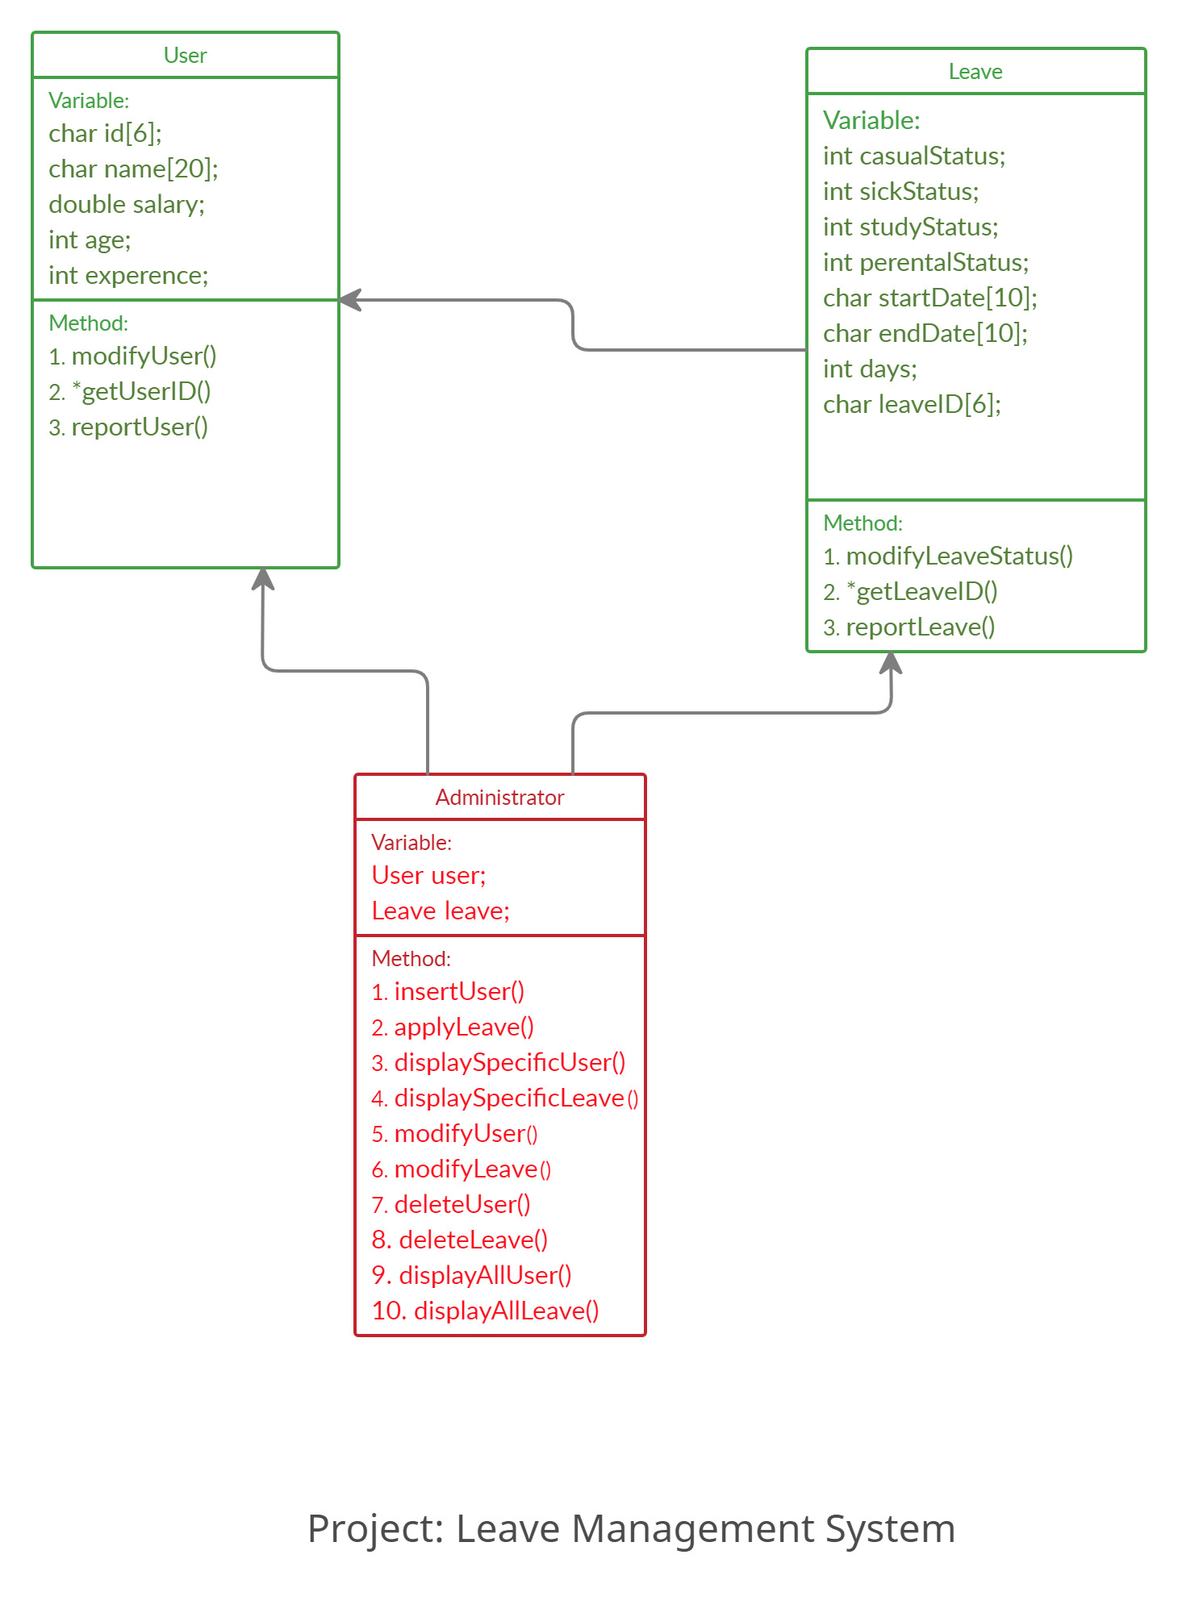
2
Project Diagram:

Slide 3

3
CLASS USED IN PROJECT:
User
Leave
Administrator

Slide 4
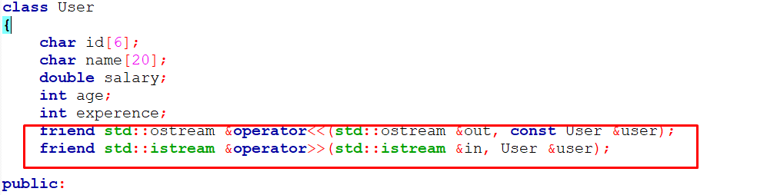
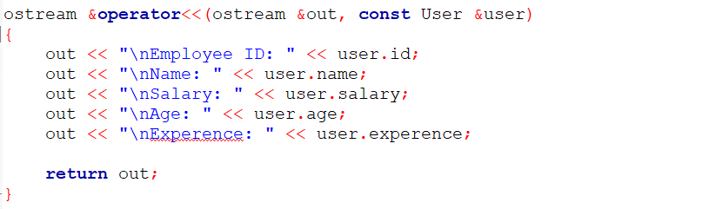
Operator Overloading IN PROJECT:
4

Slide 5
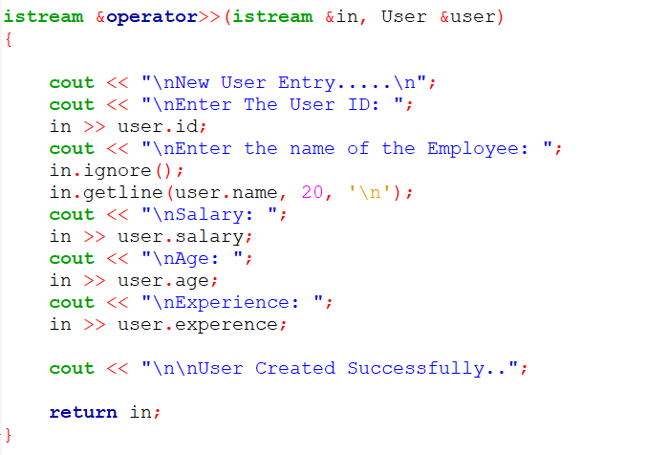
LEAVE Management System ID: 194113
Operator Overloading IN PROJECT:
5

Slide 6
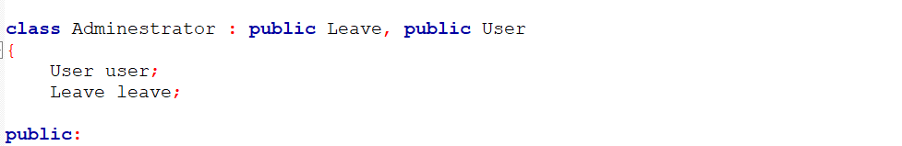
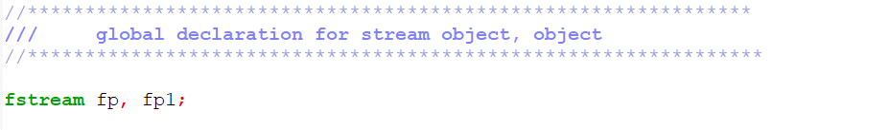
Inheritance Used In Project:
6
File Declare In Project:
File Name:
user.dat
leave.dat
temp.dat

Slide 7
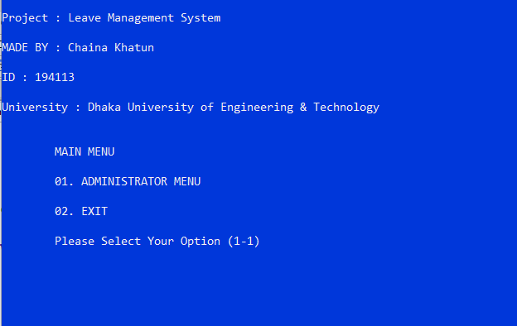
Project Output Sample:
7
When Start Project:

Slide 8
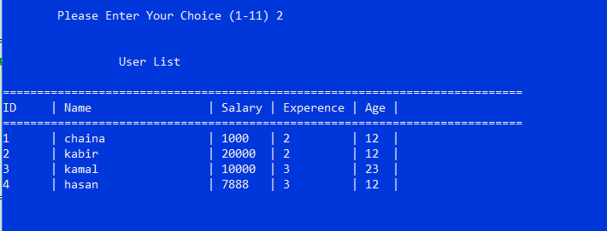
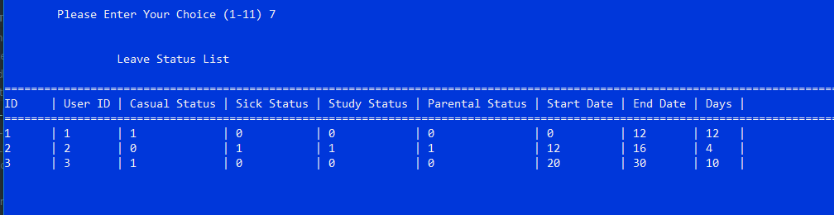
Display View All USER:
8
Display View All LEAVE:

Slide 9
Acknowledgement
9
Thanks to the honorable Teachers and all of the website resources used in this presentation.

Slide 10
10
Thank you

